Slide 1

WATER QUALITY ANALYTICS
India Water Quality Analysis
A Data-Driven Assessment of Chemical, Biological & Regional Water Safety Across 1,000 Sampled Sites
1,000 Samples | 17 States | 7 Water Sources

Slide 2


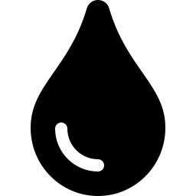
Dataset Overview
Structure and definition of the 1,000-sample water quality dataset
1,000
Column | Description
Sample_ID | Unique identifier assigned to each water sample record
State | Indian state where the sample was collected
Water_Source | Origin type — River, Lake, Well, Groundwater, Reservoir, Pond, Tap
pH / Temperature_C | Baseline physical and acid-alkaline stability readings
Turbidity_NTU / DO_mg/L | Water clarity and dissolved oxygen available for aquatic life
BOD_mg/L / COD_mg/L | Biological and chemical oxygen demand — organic pollution load
Lead / Nitrate / Fluoride | Heavy metal and chemical contamination concentrations (mg/L)
Calcium / Magnesium / Hardness | Mineral concentration and total water hardness profile
Total_Coliform | Bacterial indicator of biological / sewage contamination
WQI_Score / WQI_Class | Composite Water Quality Index and its Excellent–Poor classification
Water Samples
17
Indian States
7
Water Source Types
India Water Quality Analysis
2 / 9

Slide 3
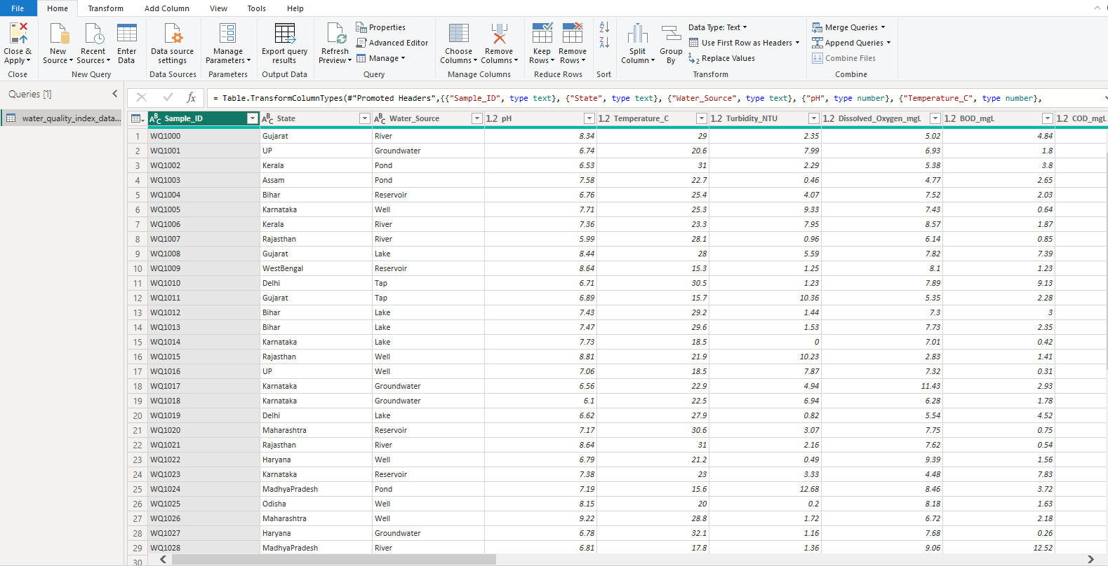

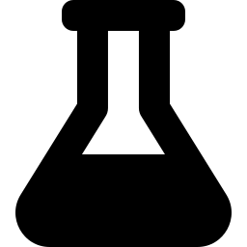


Data Cleaning & Preparation
Power Query transformation pipeline behind the analysis-ready dataset
Standardization
Column headers, state names, and water-source labels normalized to consistent text casing and category values across all 1,000 rows.
Null Handling
Missing chemical readings (pH, Lead, Fluoride, etc.) imputed using state/source-level medians; incomplete records with critical gaps removed.
Outlier Removal
Values outside physically plausible ranges (e.g. negative concentrations, extreme pH) flagged via IQR bounds and corrected or excluded.
WQI Calculation
Weighted Water Quality Index computed from 9 core parameters, then binned into Excellent / Good / Medium / Poor classes.
Power Query Editor — water_quality_index_data source transformation
India Water Quality Analysis
3 / 9

Slide 4

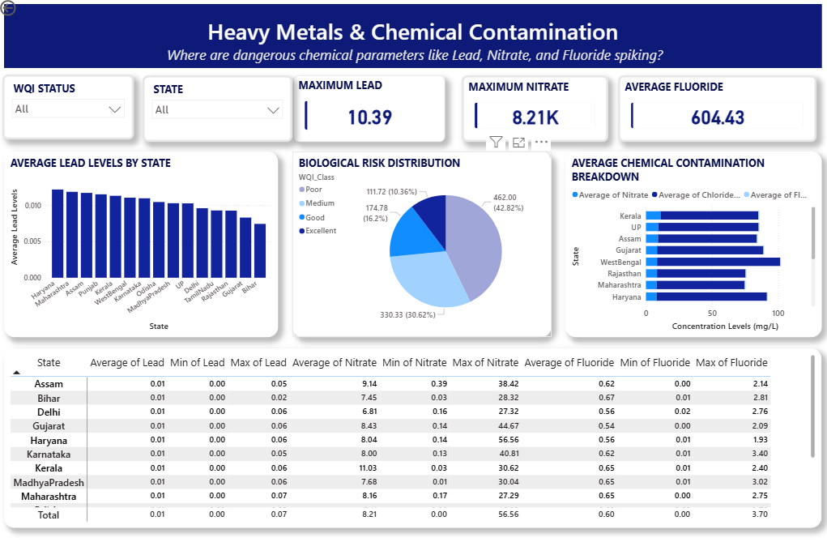


Heavy Metals & Chemical Contamination
Problem Detected — Lead, Nitrate, and Fluoride concentrations spike sharply in specific states, exceeding safe thresholds in isolated pockets.
INSIGHTS
Haryana and Maharashtra post the highest average Lead levels, exceeding the state median by over 20%.
Peak Nitrate readings reach 8.21K mg/L in outlier samples, far above WHO drinking-water limits.
Average Fluoride sits at 604.43 across flagged samples, concentrated in groundwater and well sources.
42.8% of samples fall into the Poor biological-risk band, correlating with chemical spikes.
RECOMMENDATIONS
Prioritize Lead and Fluoride remediation infrastructure in Haryana, Maharashtra, and West Bengal.
Install nitrate-selective filtration at groundwater and well extraction points in high-risk states.
Establish quarterly heavy-metal monitoring checkpoints for the lowest-scoring 20% of sites.
Cross-reference chemical outliers with nearby industrial or agricultural runoff sources.
India Water Quality Analysis
4 / 9

Slide 5
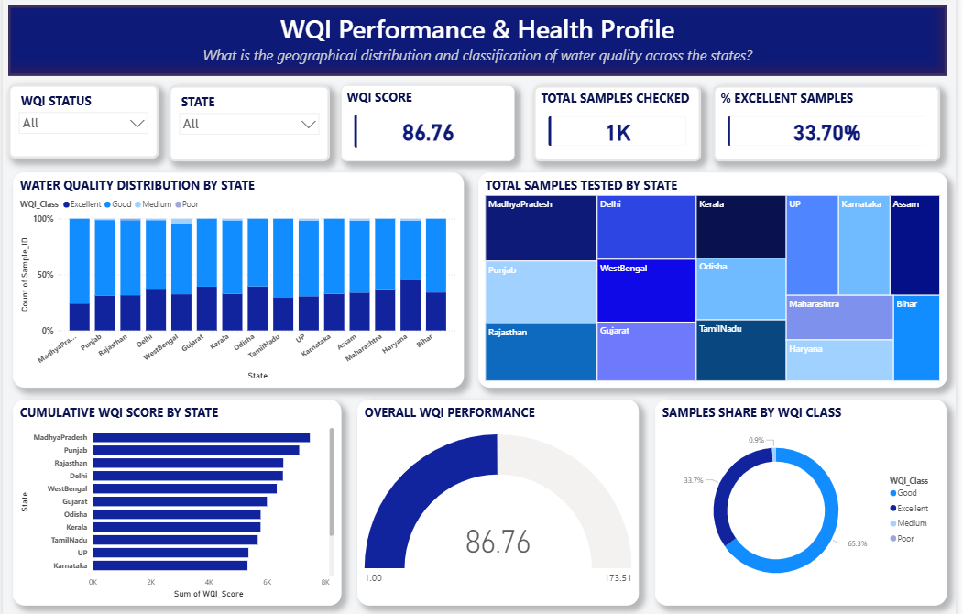
WQI Performance & Health Profile
Problem Detected — Overall WQI averages 86.76, but sample classification is uneven across states, with excellent-grade water under-represented.
INSIGHTS
Only 33.70% of the 1,000 samples tested achieve an Excellent WQI classification.
Madhya Pradesh, Punjab, and Rajasthan contribute the highest cumulative WQI scores by state.
Haryana and Bihar show a visibly higher share of Excellent-grade samples than other states.
65.3% of samples fall in the Good band — solid, but with clear room to shift toward Excellent.
RECOMMENDATIONS
Set a target to lift Excellent-grade share from 33.7% toward 45% within the next assessment cycle.
Study Haryana and Bihar's sourcing and treatment practices as replicable best-practice models.
Direct improvement investment toward states clustering in the Medium and Poor WQI bands.
Publish state-level WQI scorecards to drive accountability and track quarter-over-quarter change.
India Water Quality Analysis
5 / 9

Slide 6
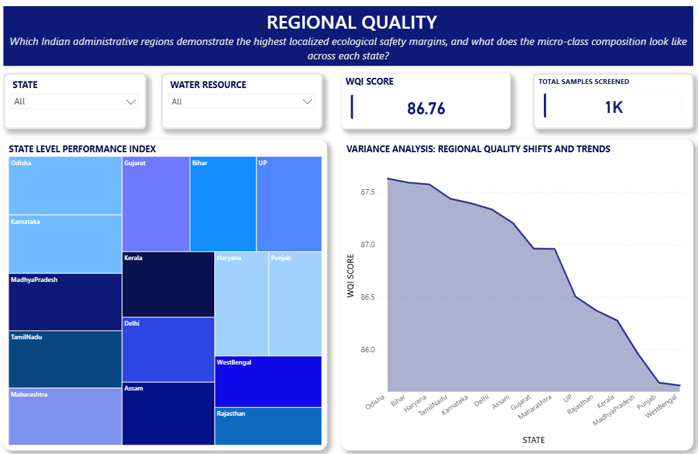
Regional Quality
Problem Detected — Localized ecological safety margins vary meaningfully by state, with a clear downward gradient from top to bottom performers.
INSIGHTS
Odisha leads the state-level performance index, followed closely by Bihar and Haryana.
WQI scores trend downward steadily from Odisha (~87.7) to WestBengal (~85.8) across all 17 states.
Punjab and WestBengal cluster at the lower end of the regional quality spectrum.
Micro-class composition shows Kerala and Delhi maintaining a strong share of high-grade samples.
RECOMMENDATIONS
Treat WestBengal and Punjab as priority zones for infrastructure and treatment upgrades.
Benchmark lagging states against Odisha and Bihar's source management and testing cadence.
Introduce regional variance tracking to catch quality shifts before they compound.
Align resource allocation with the state-level performance index, not just national averages.
India Water Quality Analysis
6 / 9

Slide 7
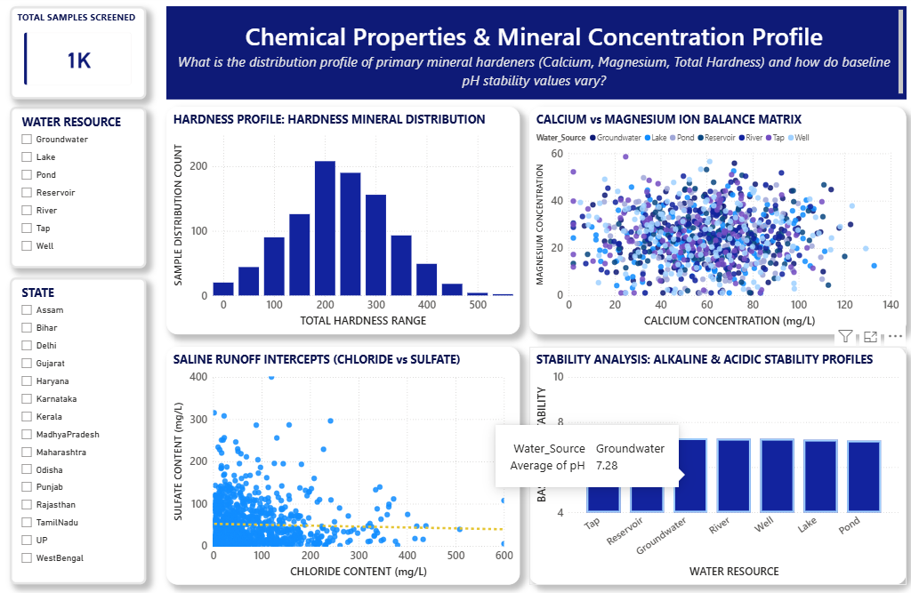
Chemical Properties & Mineral Concentration
Problem Detected — Total hardness and mineral loads cluster in a wide mid-range band, with pH stability varying meaningfully by water source.
INSIGHTS
Total hardness distribution peaks between 150-250 mg/L, indicating widespread moderately hard water.
Calcium and Magnesium concentrations show a broad, dispersed relationship with no single dominant source.
Chloride vs Sulfate readings reveal scattered high-chloride outliers suggesting saline runoff intercepts.
Groundwater sits at a stable average pH of 7.28, closely matched by Tap and Reservoir sources.
RECOMMENDATIONS
Deploy targeted water-softening treatment in zones with hardness readings above 250 mg/L.
Investigate high-chloride outlier sites for saline intrusion or agricultural runoff contamination.
Maintain current pH stabilization practices for Groundwater and Tap sources as the benchmark.
Expand Calcium/Magnesium monitoring frequency at sites showing high ion-balance variability.
India Water Quality Analysis
7 / 9

Slide 8
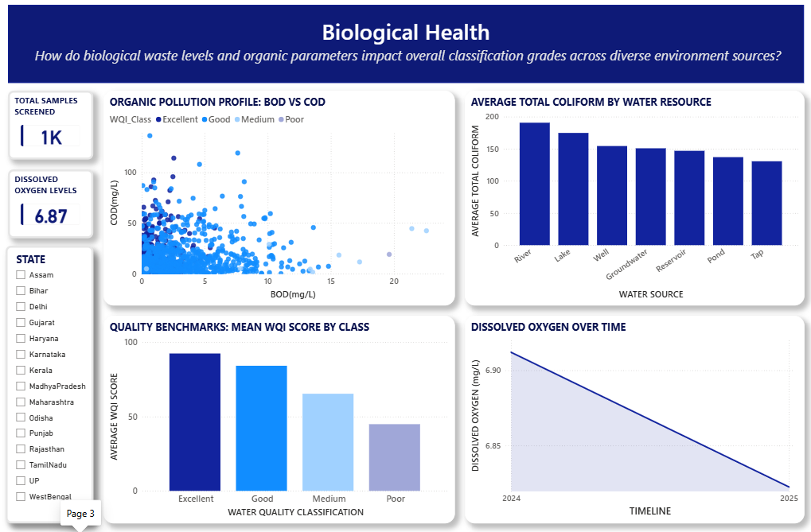
Biological Health
Problem Detected — Organic pollution and coliform levels vary sharply by water source, with dissolved oxygen trending downward over time.
INSIGHTS
River and Lake sources carry the highest average Total Coliform counts of all seven source types.
BOD vs COD scatter shows most samples clustering low, with a distinct high-COD outlier group.
Mean WQI score drops sharply from Excellent to Poor class, confirming biological load drives grade.
Dissolved Oxygen has declined from ~6.92 to ~6.87 mg/L between the 2024 and 2025 measurement periods.
RECOMMENDATIONS
Prioritize coliform disinfection upgrades at River and Lake collection points.
Investigate the high-COD outlier cluster for point-source industrial or sewage discharge.
Reinforce biological treatment standards for sites trending toward the Medium/Poor WQI classes.
Monitor the Dissolved Oxygen downward trend closely — intervene before it crosses safe thresholds.
India Water Quality Analysis
8 / 9

Slide 9
Conclusions
Five core takeaways from the chemical, biological, and regional analysis
Chemical hotspots are concentrated, not widespread
1
Lead, Nitrate, and Fluoride spikes cluster in a handful of states (Haryana, Maharashtra, West Bengal) — targeted intervention will outperform blanket measures.
Water quality is good on average, excellent-grade water is scarce
2
An 86.76 mean WQI masks the fact that only 33.7% of samples reach Excellent — most water is safe but not optimal.
Regional performance follows a clear gradient
3
Odisha, Bihar, and Haryana consistently outperform; Punjab and West Bengal consistently lag across independent dashboards.
Mineral and pH profiles are broadly stable
4
Hardness and pH stay within manageable ranges across most sources, with isolated high-chloride and high-hardness pockets needing attention.
Biological load is the leading indicator of WQI decline
5
Coliform counts and the BOD/COD relationship track tightly with WQI class, and dissolved oxygen's downward trend is an early warning worth monitoring.
India Water Quality Analysis | 1,000 Samples | 17 States

